Slide 1
Telehealth Overview
What Do You Need to Know?

Slide 2
Definition: Telehealth
A tool for enhancing health care, public health, and health education delivery and support, using electronic communication and information.
Providing/receiving health care services at a distance.

Slide 3
Telehealth:
Telemedicine
Remote Monitoring
Store-and-Forward
Direct-to-Consumer/Primary Care
Mobile Health (apps-based)
Notes:
Telehealth is a collection of means or methods for enhancing health care, public health, and health education delivery and support using telecommunications technologies

Slide 4
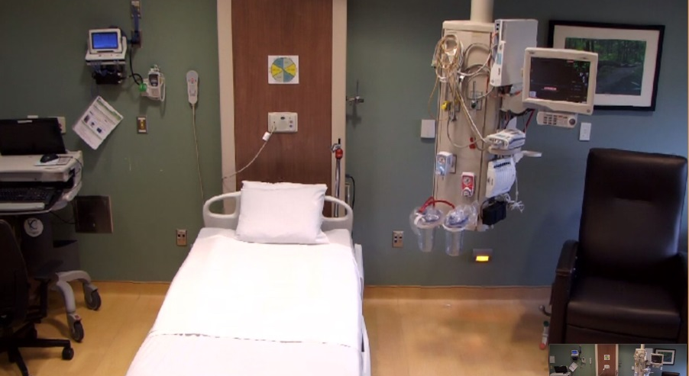
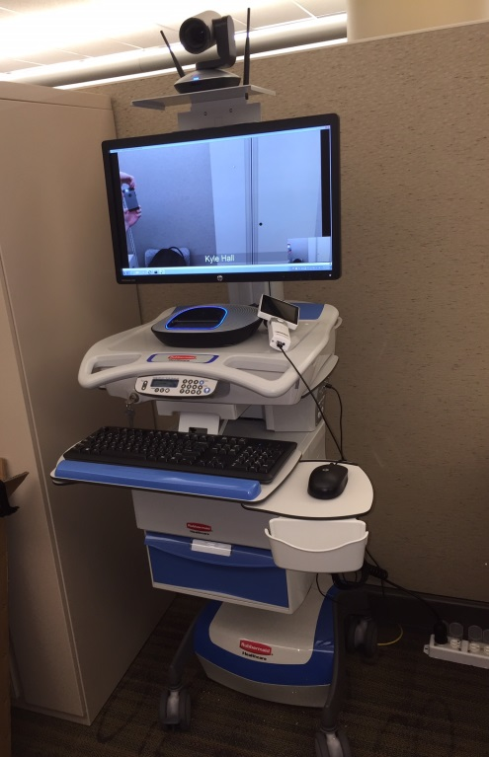
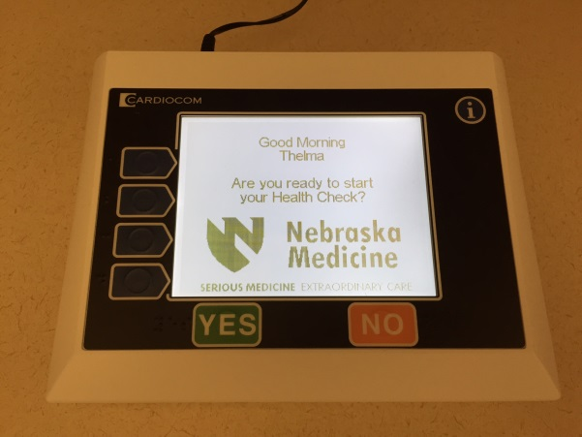
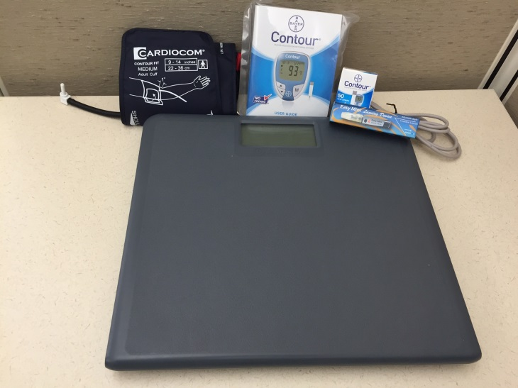
Telehealth @ Nebraska Medicine

Slide 5
What does it take to get started?
Know who you want to serve
Know why you want to provide the service
Know your established and potential referral patterns/volumes (where are your patients coming from?)
Relationships!

Slide 6
Involve telehealth department in initial planning
We will…
Provide guidance in establishing your service at a distance
Walk through the administrative aspects of establishing the service
Have access to helpful resources (internal and external)

Slide 7
ISSUES TO CONSIDER:

Slide 8
Relationships
Target locations/communities where you have established relationships
Know where your patients will go to access your service
Understand that this isn’t just your/your providers’ decision
Do you have an established referral relationship with the locations from which you would like to see patients
Are they supportive of the service
Have you (or your local champion) proposed the service to their managing organizational administration
Do they have technology/staff/willingness/space to support the service

Slide 9
Clinical Considerations
Is staff needed to support services?
with patients
with provider
What labs/tests are needed?
What local resources are available?
Referral resources
Ancillary services
EMR/Patient Information
Scheduling
Documentation

Slide 10
Billing/Reimbursement
Dependent upon:
Community where service is received
Location where patient is receiving the service
Provider type
Type of service being delivered
Insurance provider and coverage (Medicare, Medicaid, Other)
Professional billing codes
GT modifier
Remote site originating fee
May be available (Medicare, yes – Medicaid, Jan. 1, 2017 – others, ?)
Non-billable services

Slide 11
Legal/Regulatory Issues
Service Contract
General Telehealth Services Agreement signed by administrator at the patient side
Would NOT include on-site services/space lease
One contract that covers all potential telehealth services
Generally, a 3-year agreement
Schedules added as services are added.
Licensure – required for where the PATIENT is receiving care
Credentialing
By Proxy is preferred (however, not required)
Again, one general agreement with providers added/removed as needed
Stark
Have to be careful not to incentivize referrals through providing equipment
Liability
Adhere to standard of care
Also, moving more into “why DIDN’T you use it”

Slide 12
We have resources available:
Responsibilities Listing
Project Charter
Checklist
Sample Workflow
Progress Chart
Sample Contract
Sample Credentialing By Proxy Agreement
Reimbursement Information:
Medicare
Medicaid
Others

Slide 14
Contact Info:
Mary DeVany, Director
Phone: 9-6709
mdevany@nebraskamed.com
Geri Tyson, Telehealth Program Manager
Phone: 9-6039
Kyle Hall, Telehealth Coordinator
Phone: 2-4996

